Slide 1


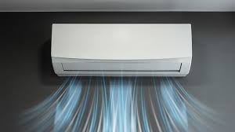

AC SHOP MANAGEMENT SYSTEM

Slide 2

PREPARED BY :-
Student Name : Abdurrehman M. Narmawala
Roll no : 112
Enrollment No. : 23002171210076
Batch : B4
Branch : CSE

Slide 3
Project Intro :
Purpose of the project
System design diagram (Flow-chart / Algorithm….)
ER Diagram
Use case Diagram
Functionalities
Used DATA Structures and class
Tools used
Merits & Demerits
Future Scope

Slide 4
Purpose Of The Project:
Manages client information for an AC shop, using a Swing-based GUI and MySQL database.
An AC Shop Management System is designed to streamline and optimize the operations of an air conditioning (AC) sales and service business. The primary purposes of an AC shop management system include:
Inventory management
Sales management
Customer Relationship Management [CRM]
Billing and invoicing, etc.

Slide 5
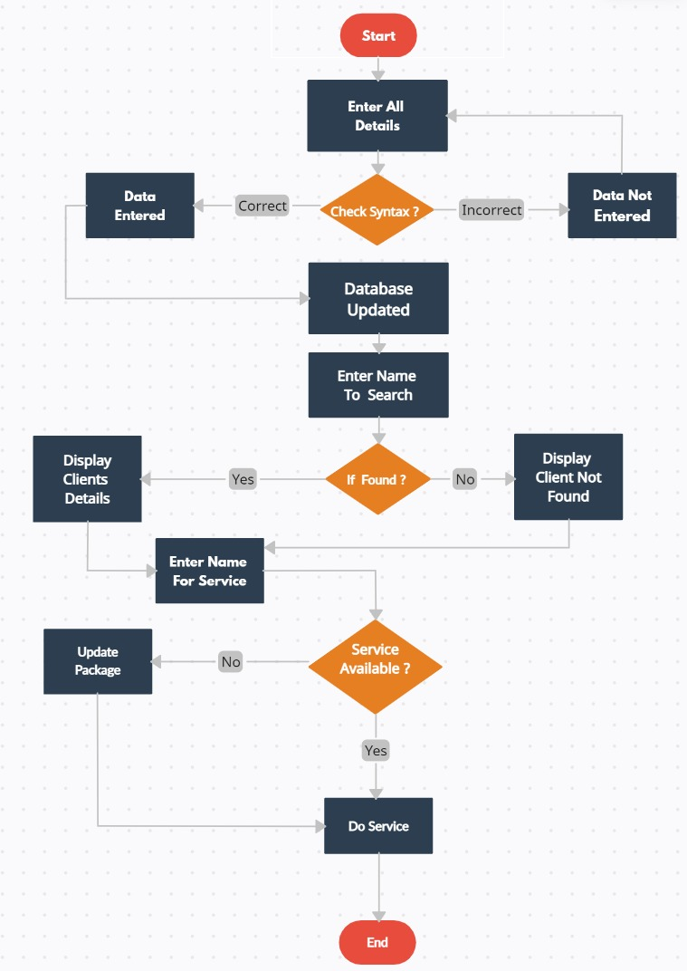
Flow Chart :

Slide 6
ER diagram :-

Slide 7
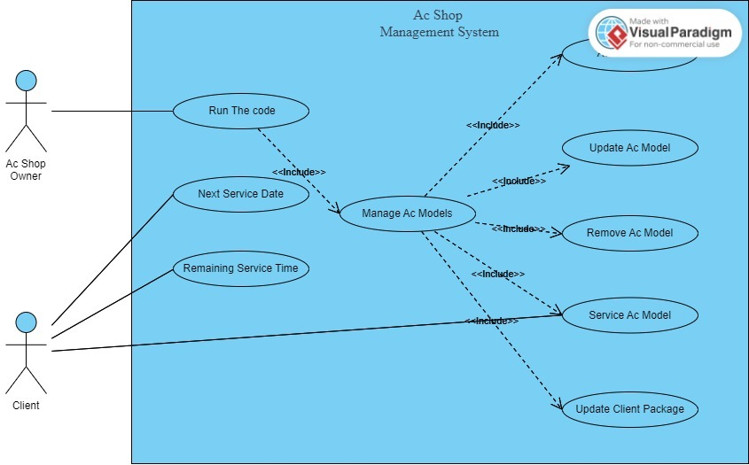
Use Case diagram :

Slide 8
Functionalities of Project Related with Each Subject :
Data Structures using JAVA | JAVA - II | DATABASE MANAGEMEN
Linked List [For Display All Clients] | 1. GUI [Graphical User Interface] For Better Presentation. | 1. CRUD Functions Of SQL And Like Query For Searching Client.
Array List For Storing Clients Objects. | 2. Date And Calendar Functions Which Deals With Real Time Complexity. | 2. Trigger For Backup of Clients.

Slide 9
USED DATA STRUCTURES & CLASSES :
1) Client Class :
Manages client details (name,dop, address, phone, acModel, price, description, service info).
Includes methods for date calculations, service renewals, and package management.
2) ClientManager Class :
Handles CRUD operations with the MySQL database via JDBC.
Manages client services, including performing and updating service packages.
3) AcManagementSystem Class :
Main application window extending JFrame.
Provides GUI elements like text fields for input, buttons for actions (add, update, remove clients, perform services), and a text area for displaying information.
4) LinkedList Class :
This Class is used for Display all Clients present in Database using temp variable.

Slide 10
Tools Used :
Database Integration :
Connects to MySQL using JDBC.
Executes SQL statements for CRUD operations on the clients table.
GUI Elements :
JTextField : For client data input and
search queries.
JButton : For actions like add, update,
remove.
TextArea : For displaying client information.

Slide 11
Workflow :
Add Client : Enter details, save to database.
Remove Client : Delete client by name.
Update Client : Modify existing client details.
Search Client : Find clients by name or DOB.
Display Clients : Show all clients in the database.
Perform Services : Update service records and schedule next service.
Update Service Packages : Reset service count and update service
dates.
The application combines a structured GUI with efficient database management for a comprehensive client management system.

Slide 12
Merits :
Improved Efficiency
Enhanced Customer Service
Improved Employee Productivity
Effective Marketing and Promotions
Customer Retention
Regulatory Compliance
Scalability , etc.

Slide 13
Demerits :
Initial Cost
Learning Curve
Ongoing Maintenance and Updates
Technical Issues and Downtime
Licensing and Subscription Costs
Dependency on Technology and Data Security Concerns ,etc .

Slide 14
Future scope :
1) Artificial Intelligence and Machine Learning Integration
Predictive Analytics & Customer Support Automation
2) Internet of Things (IoT) Integration
Smart Inventory Management & Connected AC Units
3) Cloud-Based Solutions
Scalability and Accessibility to Clients
& Data Security and Backup.
4) Enhanced Data Analytics and Business
Intelligence
Real-Time Insights & Integration with Big Data

Slide 15
Thank You !!!

